Slide 1


Network protocols & security
24EC2210
Topic:
Introduction to Computer networks
Session - 1

Slide 2



AIM OF THE SESSION
To familiarize students with the basic idea of Computer networks and its uses
INSTRUCTIONAL OBJECTIVES
This Session is designed to:
Demonstrate the need for computer networks in daily lives
Describe the components of computer networks
Describe the architectures of a computer network.
LEARNING OUTCOMES
At the end of this session, you should be able to:
Define Computer network
Describe the components that are used in construction of computer networks
Summarize the uses of computer networks

Slide 3
SESSION INTRODUCTION
Computer Network: A collection of autonomous computers interconnected by a single technology.
Two computers are said to be interconnected if they are able to exchange information.
The aim of the computer network is the sharing of resources among various devices.
In the case of computer network technology, there are several types of networks that vary from simple to complex level.
A Computer Network consists of a collection of computers, printers and other equipment that is connected together so that they can communicate with
each other

Slide 4
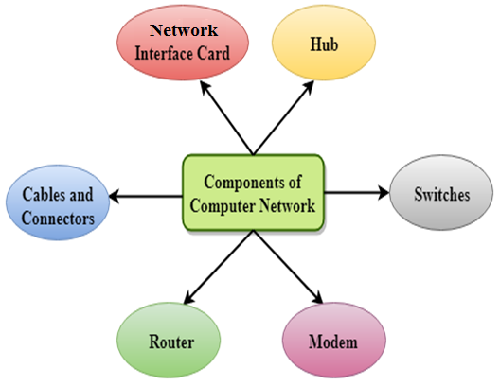
COMPONENTS OF COMPUTER NETWORKS
A computer network comprises the following components:
A minimum of at least 2 computers.
Cables that connect the computers to each other, although wireless communication is becoming more common.
A network interface device on each computer (this is called a network interface card or NIC).
A switch used to switch the data from one point to another. Hubs are outdated and are little used for new installations.
A router that connects two or more networks or subnetworks.
A modem that is used especially to transmit and receive information between computers via landlines

Slide 5
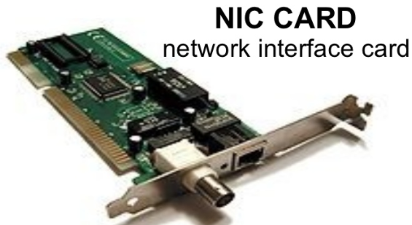
Components of computer networks…
NIC(National interface card)
NIC is a device that helps the computer to communicate with another device.
The network interface card contains the hardware addresses
The data-link layer protocol use this address to identify the system on the network so that it transfers the data to the correct destination.
Types of NIC
Wireless NIC:
All the modern laptops use the wireless NIC. In Wireless NIC, a connection is made using the antenna that employs the radio wave technology.
Wired NIC:
Cables use the wired NIC to transfer the data over the medium.

Slide 6
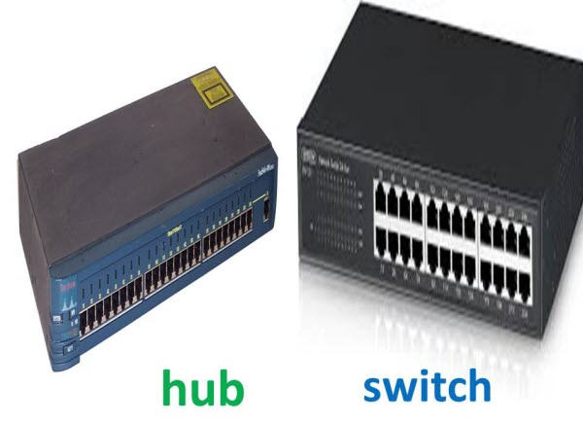
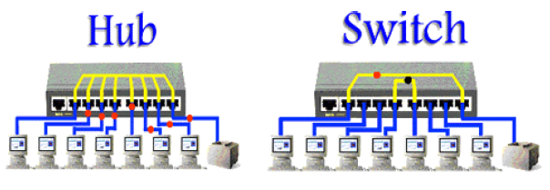
Components of computer networks…
Hub
Hub is a central device that splits the network connection into multiple devices.
When computer requests for information from another computer, it sends the request to the Hub.
Hub distributes this request to all the interconnected computers.
Switch
Switch is a networking device that groups all the devices over the network to transfer the data to another device.
A switch is better than Hub as it does not broadcast the message over the network, i.e., it sends the message to the device for which it belongs to.
Therefore, we can say that switch sends the message directly from source to the destination.

Slide 7
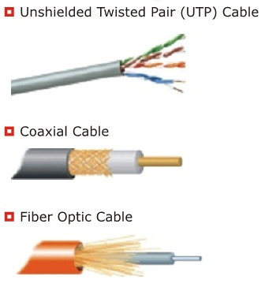
Components of computer networks…
Cables and connectors
Cable is a transmission media that transmits the communication signals.
Three types of Cables:
Twisted pair cable: High-speed cable that transmits the data over 1Gbps or more.
Coaxial cable: Resembles like a TV installation cable. Coaxial cable is more expensive than twisted pair cable, but it provides the high data transmission speed.
Fibre optic cable: High-speed cable that transmits the data using light beams. It provides high data transmission speed as compared to other cables. It is more expensive as compared to other cables, so it is installed at the government level.

Slide 8
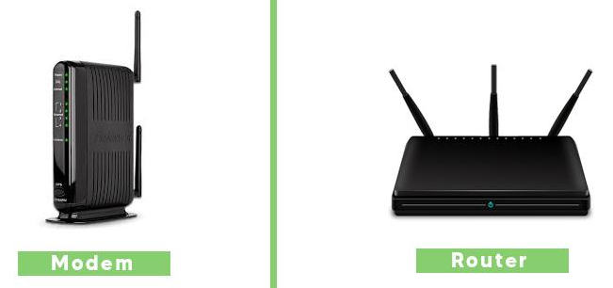
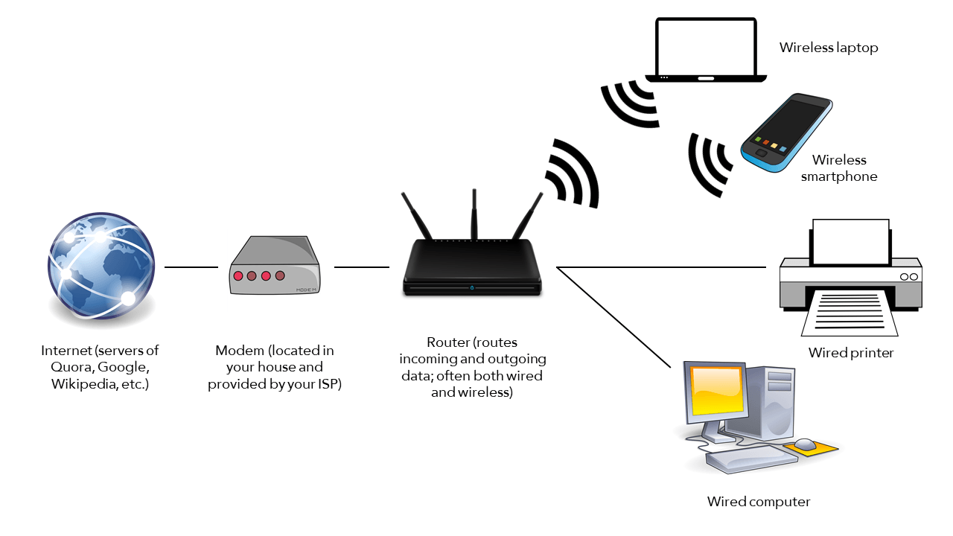
Components of computer networks…
Modem
Modem connects the computer to the internet over the existing telephone line.
A modem is not integrated with the computer motherboard.
A modem is a separate part on the PC slot found on the motherboard.
Router
Router is a device that connects the LAN to the internet.
The router is mainly used to connect the distinct networks or connect the internet to multiple computers.

Slide 9
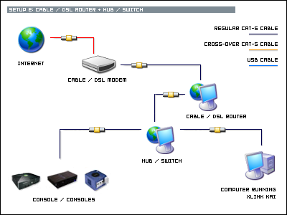
Sample Network

Slide 10
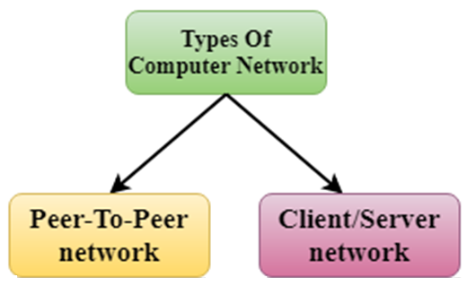
COMPUTER NETWORK ARCHITECTURE
Computer Network Architecture is defined as the physical and logical design of the software, hardware, protocols, and media of the transmission of data.
Simply we can say that how computers are organized and how tasks are allocated to the computer.

Slide 11
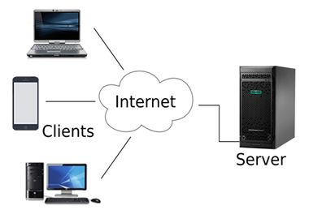
Client/server network
Is a network model designed for the end users called clients, to access the resources such as data, songs, video, etc. from a central computer known as Server.
The central controller is known as a server while all other computers in the network are called clients.
A server performs all the major operations such as security and network management.
A server is responsible for managing all the resources such as files, directories, printer, etc.
All the clients communicate with each other through a server. For example, if client1 wants to send some data to client 2, then it first sends the request to the server for the permission. The server sends the response to the client 1 to initiate its communication with the client 2.

Slide 12
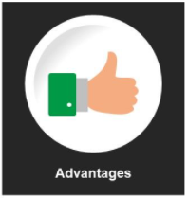

Client/server network
Contains the centralized system. Therefore, we can back up the data easily.
Has a dedicated server that improves the overall performance of the whole system.
Security is better as a single server administers the shared resources.
It also increases the speed of the sharing resources.
Client/Server network is expensive as it requires the server with large memory.
A server has a Network Operating System(NOS) to provide the resources to the clients, but the cost of NOS is very high.
It requires a dedicated network administrator to manage all the resources.

Slide 13
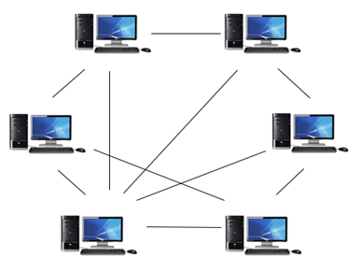
Peer-To-Peer network
Is a network in which all the computers are linked together with equal privilege and responsibilities for processing the data.
Useful for small environments, usually up to 10 computers.
Has no dedicated server.
Special permissions are assigned to each computer for sharing the resources, but this can lead to a problem if the computer with the resource is down.

Slide 14
Peer-To-Peer network
It is less costly as it does not contain any dedicated server.
If one computer stops working, other computers will not stop working.
It is easy to set up and maintain as each computer manages itself.
In the case of Peer-To-Peer network, it does not contain the centralized system. Therefore, it cannot back up the data as the data is different in different locations.
It has a security issue as the device is managed itself.

Slide 15
USES OF COMPUTER NETWORKS
Business Applications
Home Applications
Mobile Users
Social Issues

Slide 16
Business Applications
Resources and data sharing (Client/Server Model)
A computer network can provide a powerful communication medium among employees(e-mail, online reports, video conferencing, etc.)
Doing business electronically with other companies, especially suppliers and customers. For example, manufacturers of automobiles, aircraft, computers, etc. buy subsystems from a variety of suppliers and then assemble the parts. Using computer networks, manufacturers can place orders electronically as needed.
Doing business with consumers over the Internet. E-commerce: Many companies provide catalogs of their goods and services online and take orders on-line.

Slide 17
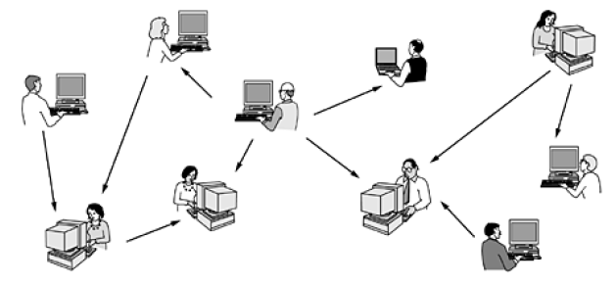
Home Applications
Access to remote information
Surfing the World Wide Web for information or just for fun.
Information available includes the arts, business, cooking, government, health, history, hobbies, recreation, science, sports, travel, and many others.
Person-to-person communication
Peer-to-Peer communication
Interactive entertainment
Movies, Online video gaming, Online interactive quizzes, etc.
Electronic business
Home shopping, Online banking, Online payments, etc

Slide 18
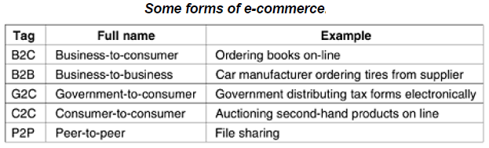

Slide 19
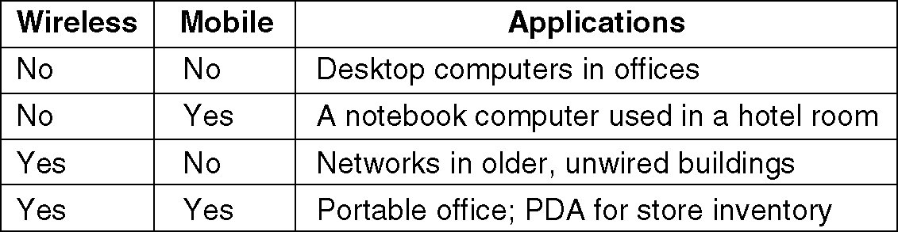
Mobile users
Combination of wireless networks and mobile computing.

Slide 20
Social issues
Topics that people actually care about, like
Politics
Religion
Societal issues, etc.

Slide 21
SELF-ASSESSMENT QUESTIONS
Which among the following represents the characteristics of a computer network?
Information Sharing
Resource Sharing
Both
d. Neither a or b
Broadcasting is done through which computer network device?
Hub
Switch
Both a & b
Neither a nor b
3. The device that processes request is called _____?
Client
Server
Process
None

Slide 22
SELF-ASSESSMENT QUESTIONS: Answers
Which among the following represents the characteristics of a computer network?
Information Sharing
Resource Sharing
Both a & b
Neither a or b
Broadcasting is done through which computer network device?
Hub
Switch
Both a & b
Neither a nor b
3. The device that processes request is called _____?
Client
Server
Process
None

Slide 23

SUMMARY
Definition of Computer Network
Components of Computer Network
Computer Network Architecture
Uses of Computer Networks

Slide 24
TERMINAL QUESTIONS
1. Describe the term Computer network.
2. List out the components of computer networks.
3. Analyze Client-server and Peer-to-peer network architectures.
4. Summarize the uses of computer networks in our daily lives.

Slide 25
REFERENCES FOR FURTHER LEARNING OF THE SESSION
Reference Books:
A.S. Tanenbaum, David J. Wetheral “Computer Networks” Pearson, 5th Edition.
Kurose, J and Ross, K Computer Networking: A Top-Down Approach Addison-Wesley- 6th edition.
Sites and Web links:
1. https://www.javatpoint.com/computer-network-components
2. https://www.javatpoint.com/computer-network-architecture

Slide 26
THANK YOU
Team – Network Protocols & Security

